Slide 1
WHERE TO LOCATE A NEW RESTAURANT

Slide 2
Backgrounds
Plan to open a new Chinese restaurant
Two options: close to either the University of Toronto or the University of British Columbia

Slide 3
Problems to be solved
How many Chinese restaurants list around the two campuses?
Which streets do they locate at?
How about other Asian-flavor restaurants?
What kind of Chinese food are the existing Chinese restaurants serving?

Slide 4
Target Audience
People who have interests in launching a new Chinese restaurant near the University of Toronto or the University of British Columbia college town.

Slide 5
Data Source
Geopy.geocoders
FourSquare API
Explore. To find the nearby venues around.
Categories id. To focus on Chinese food.
Venue stats. Get total check-in and sharing numbers of a venue.

Slide 6
Data Acquiring
Create the grid of cells near the center of the campus.
The University of Toronto: 5km
The University of British Columbia: 8km
(because of its special geological surrounding)

Slide 7
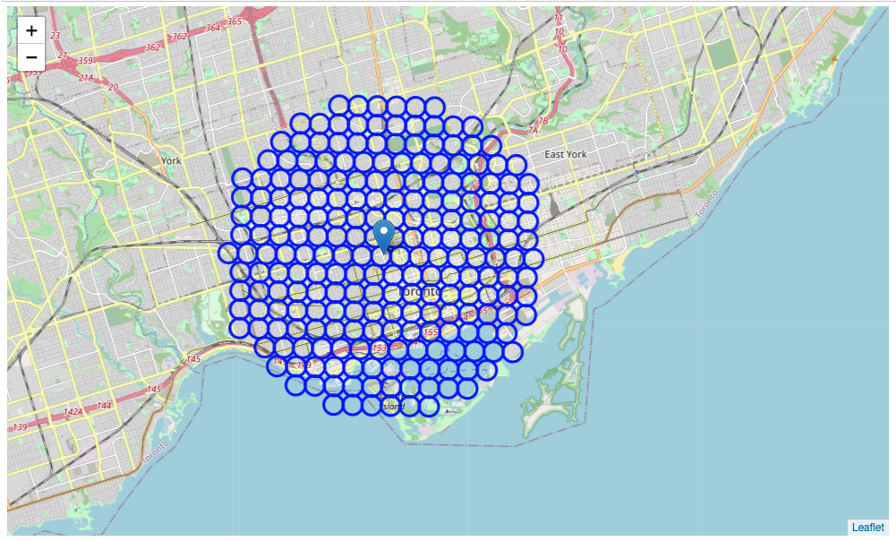
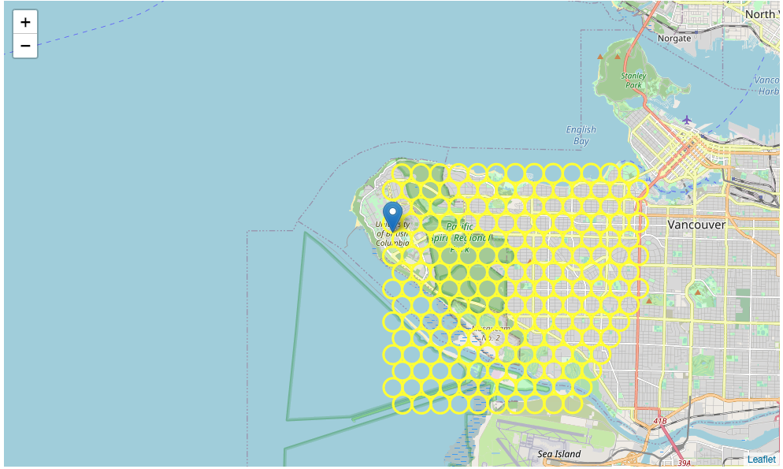
The University of Toronto
The University of British Columbia
228 candidates generated.
119 candidates generated.

Slide 8
Data Acquiring
Using FourSquare API to get Asian-flavor restaurants and Chinese restaurants.
The more Asian-flavor restaurants located in the neighborhood, the more residents around there are interested in Asian-flavor food.

Slide 9
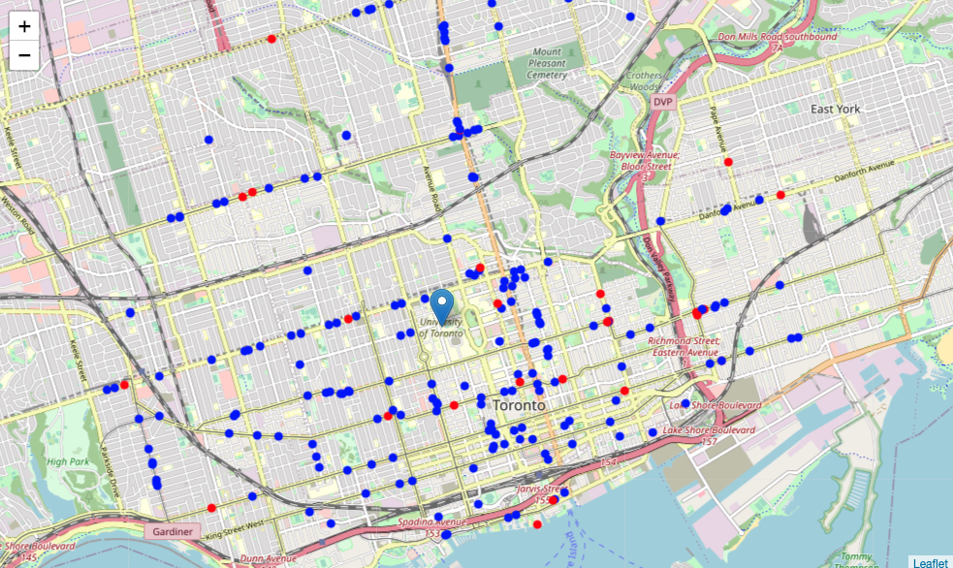
The Universities of Toronto
216 Asian-flavor restaurants around.
Among them, 25 are Chinese restaurants.
Blue circle: Asian-flavor restaurants
Red circle: Chinese restaurants

Slide 10
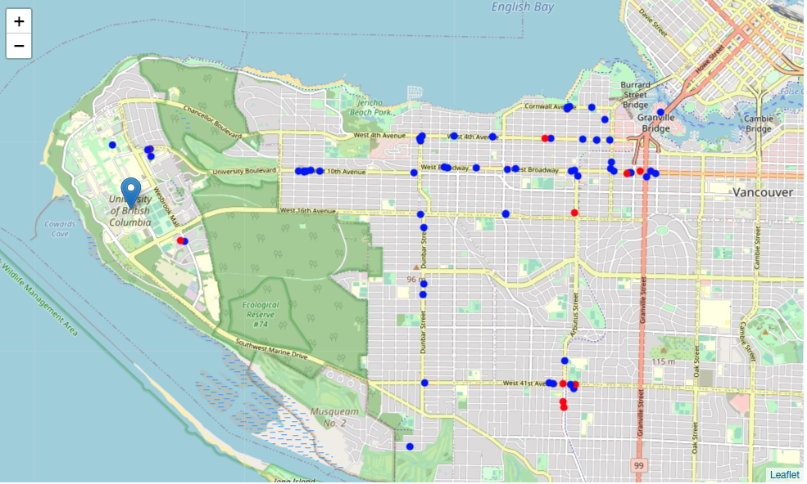
The Universities of British Columbia
68 Asian-flavor restaurants around.
Among them, 10 are Chinese restaurants.
Blue circle: Asian-flavor restaurants
Red circle: Chinese restaurants

Slide 11
Data Analysis
Which street has a high density of Asian-flavor restaurants while, ideally, not many Chinese restaurants are there?
Which street is closet to the campus?

Slide 12
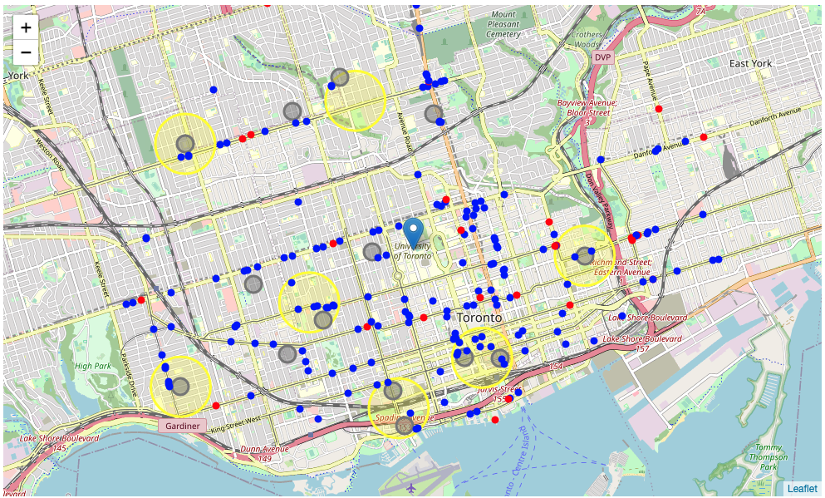
The University of Toronto
15 locations meet the requirements:
More than one Asian-flavor restaurants
Have no access to Chinese restaurants within 500 meters.
Blue circle: Asian-flavor restaurants Red circle: Chinese restaurants
Yellow: the center of clusters Gray: The best location candidates

Slide 13
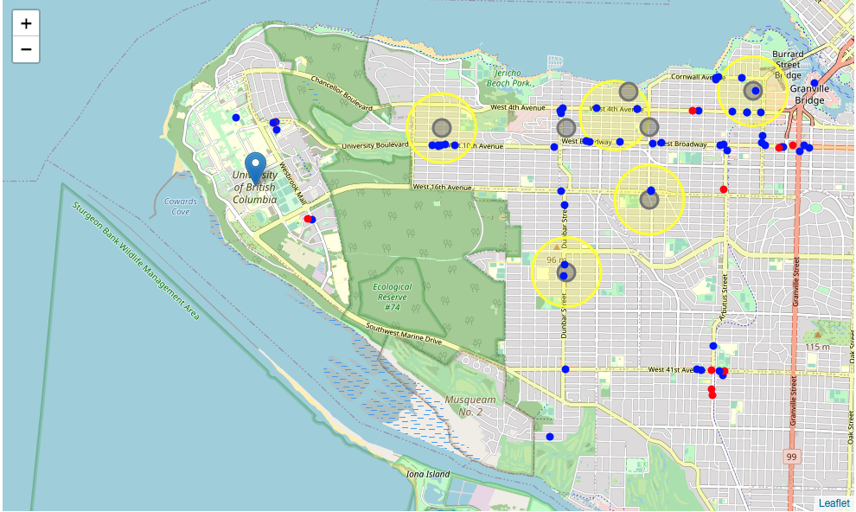
The University of British Columbia
7 locations meet the requirements:
More than one Asian-flavor restaurants
Have no access to Chinese restaurants within 500 meters.
Blue circle: Asian-flavor restaurants Red circle: Chinese restaurants
Yellow: the center of clusters Gray: The best location candidates

Slide 14
Discussion
The Universities of Toronto overall offer more options than the other to a new Chinese restaurants.
But the new restaurant might face fiercer competition if it locates near the Universities of Toronto since there are already a variety of Asian-flavor restaurants.

Slide 15
Discussion
The following promising candidates are near the UofT:
36, Maclennan Avenue, Moore Park, University—Rosedale (distance: 2.7km)
78, Bond Street, Garden District, Toronto Centre (distance: 1.9 km)
1, Harbour Square, Harbourfront, Spadina—Fort York (distance: 2.6 km)
Brookfield Place, Wellington Street West, Toronto Centre (distance: 2.1km)

Slide 16
Discussion
The following promising candidates are near the UBC:
2201, Pine Street, South Granville, Fairview, Vancouver, District of North Vancouver, Metro Vancouver Regional District (distance: 2.8km)
Nanton Avenue, Shaughnessy, Vancouver, District of North Vancouver, Metro Vancouver Regional District (distance: 4.7 km)
Continental Repairs, 1706, West 4th Avenue, South Granville, Fairview (distance: 5.3 km)
Pine Street, Shaughnessy, Vancouver, District of North Vancouver, Metro Vancouver Regional District (distance: 5.7 km)

Slide 17
Conclusion and further directions
I would recommend this location near UBC for a new Chinese restaurant: 2201, Pine Street, South Granville, Fairview, Vancouver, District of North Vancouver, Metro Vancouver Regional District (distance: 2.8km)
Further works need to be done for rental research, marketing research, and etc.

